Slide 1
CIET ( NCERT )
ICT-TOOLS WEBINAR 02.04.2024
LEARNING THROUGH DIGITAL GAMES :
EDUACTIV8 AND GCOMPRIS

Slide 2
DIGITAL GAMES
Any game that involves electronics in some way.
OR
A digital game is any game (where a game is something fun) played on a digital device such as a computer or a cellphone.
OR
A digital game is a game played using digital technology. OR
A digital game is an electronic stimulation for educational or
entertainment purposes.

Slide 3
DIGITAL GAMES
Digital games provide learners strategies, opportunities to transform traditional learning
resources, and modes from the
classroom into relevant contexts.
To highly engage learners, digital games must include rules, goals, immediate feedback, outcome evaluation, competition, and interaction.
Compared to traditional instruction, digital game-based learning has shown to be more effective in improving students’ learning.
Blended learning classrooms that lessons and digital game-based
use both traditional have the most
learning
effect on student learning.

Slide 4
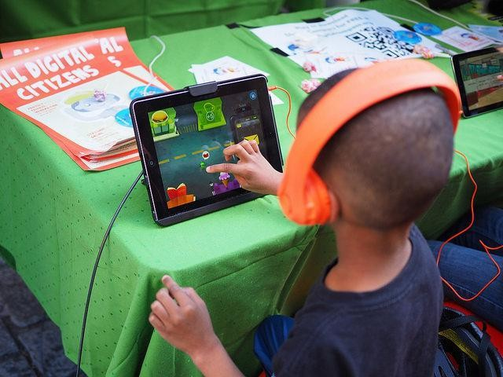
DIGITAL GAMES
1. Increases A Child’s Memory Capacity

Slide 5
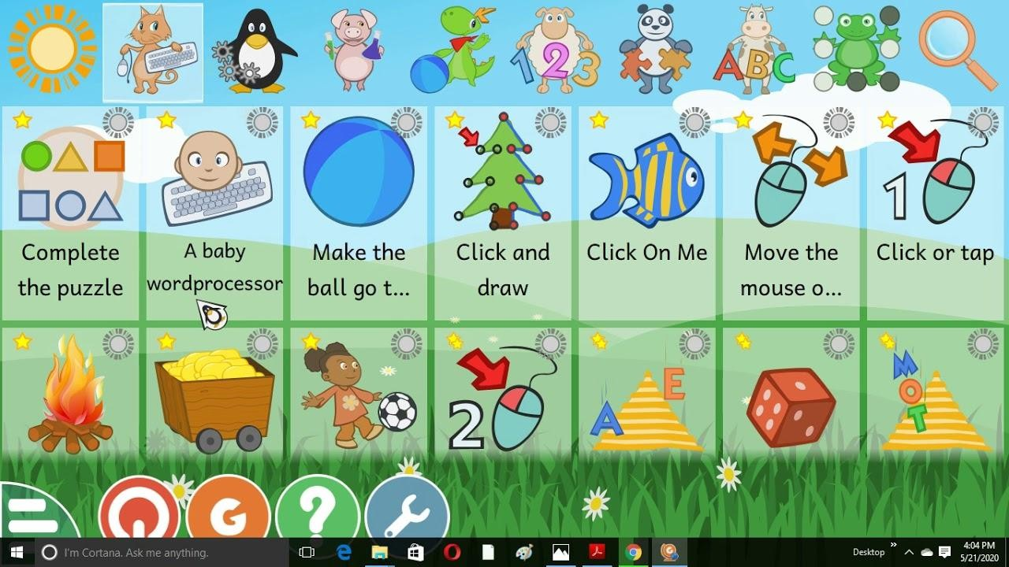
DIGITAL GAMES
2. Computer & Simulation Fluency

Slide 6
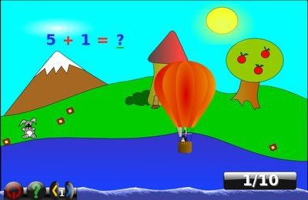
DIGITAL GAMES
3. Helps With Fast Strategic Thinking & Problem-Solving

Slide 7
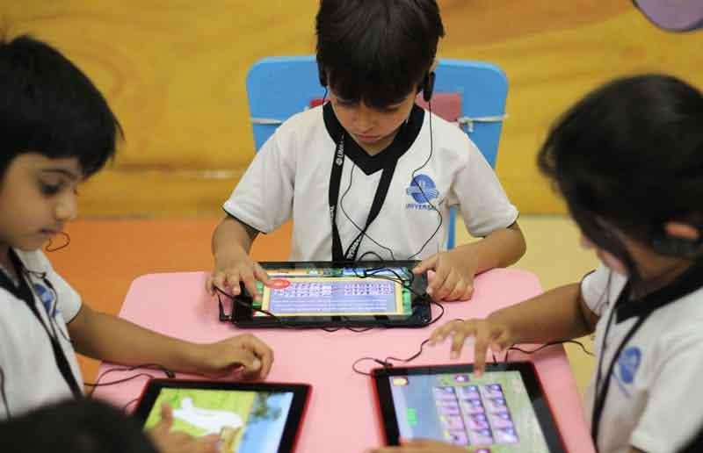
DIGITAL GAMES
4. Develops Hand-Eye Coordination

Slide 8
DIGITAL GAMES
5. Skill-Building

Slide 9
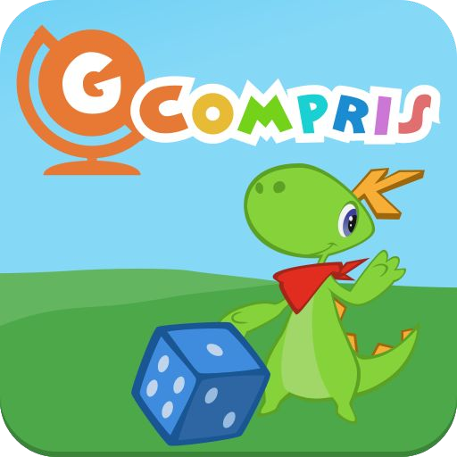
DIGITAL GAMES EDUACTIV8 GCOMPRIS

Slide 11
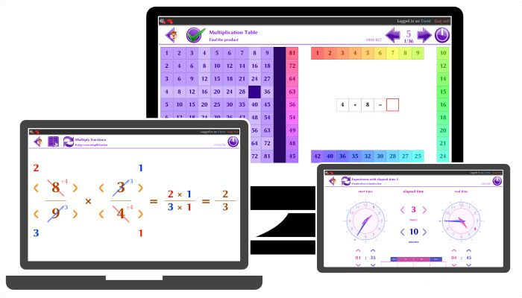
EDUACTIV8

Slide 12
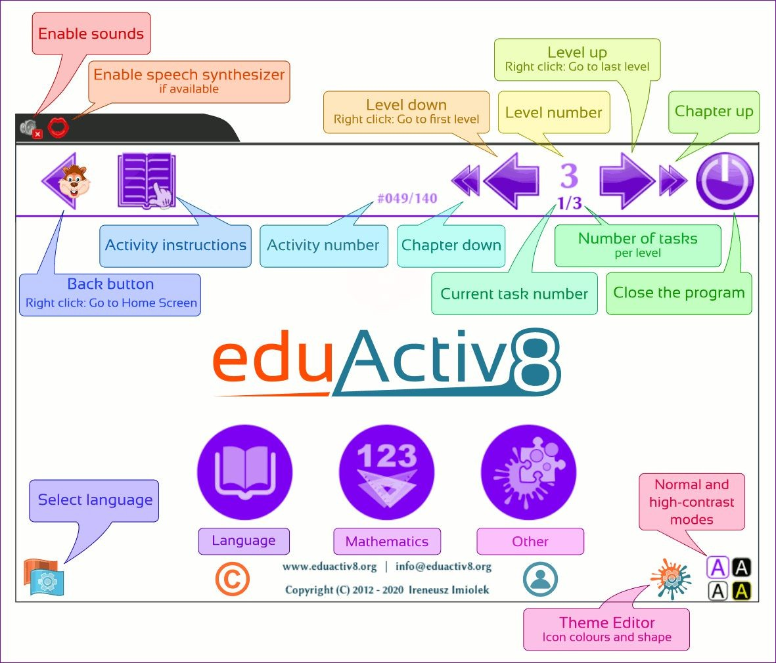
EDUACTIV8

Slide 13
EDUACTIV8
Language activities:
learn the alphabet in a selected language
learn new words in multiple categories - a variation of spelling, matching and listening activities

Slide 14
EDUACTIV8
Maths activities:
Learn numbers 1 - 20
Learn number spellings 0 - 100
Learn to count
Learn to add, subtract, multiply and divide (positive and negative numbers)
Columnar addition and subtraction, long multiplication and division
Compare and sort numbers
Fractions - also included multiple activities helpful in learning to solve problems related to addition, subtraction, multiplication and division of fractions, as well as finding equivalent fractions, etc.
Decimals, percentages and ratios
Learn shapes and solids
Learn to draw shapes
Draw symmetric shapes and find lines of symmetry

Slide 15
EDUACTIV8
Time activities:
Play with clock hands and learn how to tell time
Learn to set the clock by dragging the clock hands
Match digital time to analogue time
Learn to find a difference between two times
Learn to find time so long after or before a given time
Art and Colour activities:
Basic painting activity
Learn colour names
Learn how colours are formed both by light (RGB) and ink (CMY)

Slide 16
EDUACTIV8
Memory activities:
Memorizing a sequence of highlighted squares
Memorizing a set of directions
Memorizing locations of matching images
Other activities:
Matching shapes
Tracing lines
Finding the matching images
Multiple variations of the "Fifteen" game

Slide 17
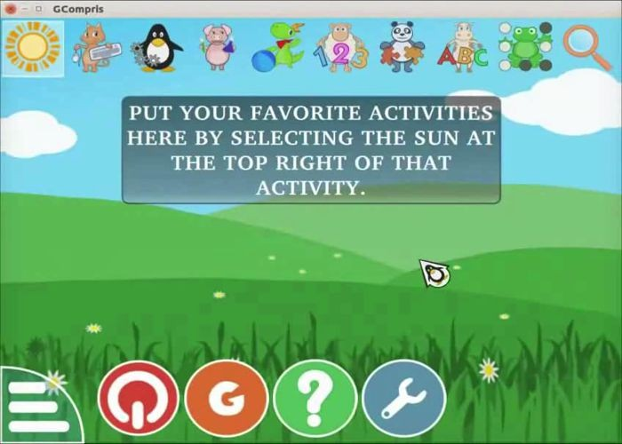
GCOMPRIS

Slide 18
GCOMPRIS
Learning how to use a computer
Practising reading with activities to learn letters, words and lexical sets
Acquiring proficiency in math by practising numeration, arithmetic, measures and puzzles
Discovering the world through logic, the arts and music
Exploring science and humanities through experimentation, history and geography
Developing strategic thinking with board games

Slide 19
GCOMPRIS
The control bar has the following icons.
Quit ,
About GCompris ,
Help
Tool box .

Slide 20
